Slide 1
National Day for Truth & Reconciliation
and Orange Shirt Day
September 30
Notes:
Total presentation approx. 70 min.

Slide 2
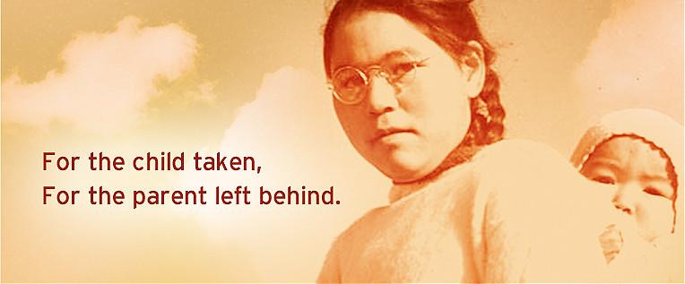

Slide 3
2015
Notes:
Video length 4:08

Slide 4
What was the purpose of the Truth and Reconciliation Committee?
The TRC’s mandate was to inform all Canadians about what happened in residential schools. The TRC documented the experiences of survivors, their families, communities and anyone personally affected by the residential school experience.

Slide 5
In December 2015, the TRC released its entire 6-volume final report. All Canadians are encouraged to read the summary or the final report to learn more about the terrible history of Indian Residential Schools and its sad legacy.
READ THE REPORTS HERE:
https://nctr.ca/records/reports/

Slide 6
Namwayut: We are all one
Chief Robert Joseph shares his experience as a residential school survivor and the importance of truth and reconciliation in Canada.
Notes:
Video length 4:20

Slide 7
Although the Indigenous people of Canada had shared many, many stories of the trauma they faced from residential schools, nothing was done. They were ignored.
It took the power of song to finally make people pay attention.

Slide 8
Gord Downie
1964 - 2017
Frontman for the Tragically Hip, an internationally renowned Canadian rock band.
One of the most riveting performers in Rock ’n’ Roll history..
Dec. 2015 - Downie was diagnosed with terminal brain cancer.
His final days were spent passionately advocating for Indigenous people and begging Canada to do better.

Slide 9
Notes:
Video length 2:30

Slide 10
The Secret Path
Gord’s Final Project
Released on October 18, 2016, the project is a 10-song concept album about Chanie Wenjack, a 12-year old Anishinaabe boy from the Marten Falls First Nation who died of starvation and exposure in 1966 while trying to return home after escaping from an Indian residential school.
Wikipedia
Notes:
Video length 1:00

Slide 11
Notes:
Video length 58:25

Slide 12
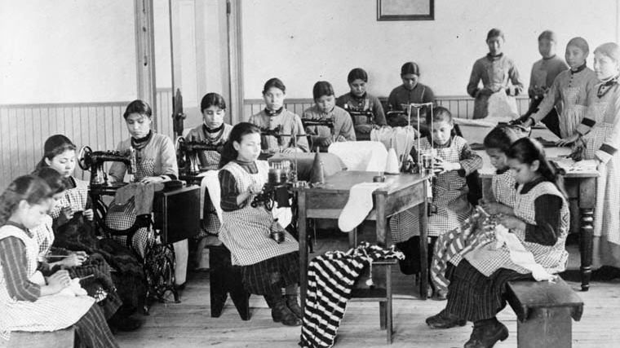
This is just a start.
Please continue the journey we’ve started today.
There are multiple resources available where you can explore truth and reconciliation - you just have to search.
Do the work. It’s crucial.

